Slide 1
SVM-Ant Colony Optimization for Identification of Protein Functions
Dr. V.K. Jayaraman
Chemical Engineering Division
National Chemical Laboratory
Pune 411 008
vk.jayaraman@ncl.res.in

Slide 2
Input Features
Computationally
inefficient
SVM
Amino acid frequencies (20)
SVM
Model
Dipeptide frequencies (400)
Physicochemical properties (560)
More features…

Slide 3
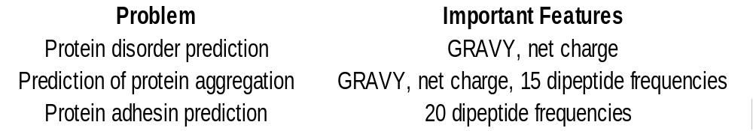
Input Features
Lesson-Use only those features that are known to be important (experiment or knowledge).
Different features may be selected, depending on their biological relevance to the problem. For example,

Slide 4
A hybrid combination of SVM and ACO may be used for simultaneous classification and feature selection

Slide 5
Input Features
Computationally
inefficient
SVM
Amino acid frequencies (20)
SVM
Model
Dipeptide frequencies (400)
Physicochemical properties (560)
More features…

Slide 6
Input Features
Lesson-Use only those features that are known to be important (experiment or knowledge).
Different features may be selected, depending on their biological relevance to the problem. For example,

Slide 7
A hybrid combination of SVM and ACO may be used for simultaneous classification and feature selection

Slide 8
Why Feature Selection?
Features can be redundant and non informative
Can hide the informative feature and confuse the classifier
Better data visualization and understanding by data reduction
Reduce the storage requirement and training time
Better training and increase in prediction confidence

Slide 9
Feature Selection Methods
Filters and Wrapper approach

Slide 10
Two approaches
D
A
T
A
Feature set
Filter
Final feature set
Heuristics
How?
D
A
T
A
Feature set
Wrapper
Final feature set
Evaluation
ML Algorithm

Slide 11
Filters
A preprocessing step which is independent of the choice of the predictor
Generally faster than the wrappers
Different Filter Methods
  Information gain
  χ² – test (CHI-test)
  Mutual information

Slide 12
Filters
For example, consider the case of classifying gene expression data of 1000 genes on n samples.
If all of the 1000 gene expression values (1000 features) are input to the SVM…
G1…
G2…
G3…
…
…
…
G1000
SVM
Classification
55% Accuracy

Slide 13
Filters
Performance improves after gene selection using ranking from a filter method:
G1…
G2…
G3…
…
…
…
G1000
Filter method
for
feature ranking
G108…
G2…
G36…
…
…
…
Top 10 ranked genes only
SVM
Classification
Accuracy> 75%

Slide 14
Wrappers
Scores subsets of features on the basis of the predictive power of the classifier method
Forward Selection
  Features are progressively incorporated, hence subset size increases after each iteration
Backward Selection
  Progressively eliminate the least important one, hence size of the dataset reduces
  Eg. SVM-RFE

Slide 15
Wrappers
Now, consider a classification problem with 20 features: X₁ ,X₂ ,X₃ ,… ,X₂₀ .
To find the 5 best features for classification, the wrapper method will :
  Generate different combinations of 5 features taken from the 20
  Train an ML classifier using these combinations
  Identify the combination of 5 features showing the best performance.

Slide 16
Wrappers
Original feature set:
Train SVM on subsets of 5:
X₁ ,X₂ ,X₃ ,… ,X₂₀
X₁₄ ,X₅ ,X₉ , X₁₃ ,X₂₀
SVM
Accuracy 67%
X₇ ,X₁₅ ,X₁₉ , X₃ ,X₆
SVM
Accuracy 78%
X₄ ,X₁₂ ,X₇ , X₁ ,X₂
SVM
Accuracy 56%

Slide 17
PROS and CONS
Filter
Fast, uses heuristics
Less accurate, operates independently of the particular induction algorithm
Wrapper
More accurate
Slower, uses the particular induction algorithm for evaluation

Slide 18
Information Gain
Evaluates the effectiveness of the feature in classifying by measuring reduction in entropy (equivalent to increase in the information) as a result of that particular feature
It requires discretization of the data

Slide 19
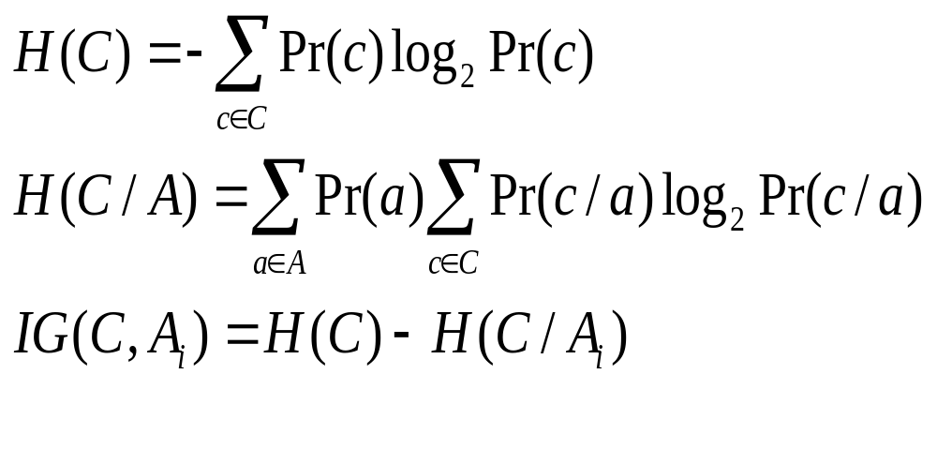
The entropy of the class with and without observing the feature is given by
Where c Є C is the set of classes and a Є A is the set of values for the feature A

Slide 20
χ² – test
Measures the discriminating power of the feature in classifying the data point into one of the possible classes
Quantifies the lack of interdependence between a
given feature and classification category
Higher value of χ² implies higher imformativeness of the feature

Slide 21
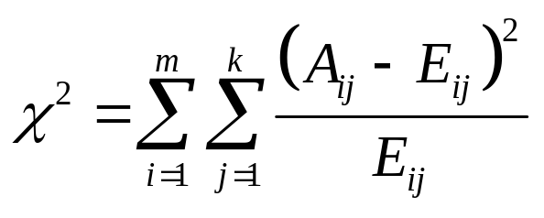
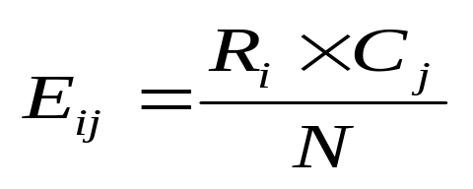
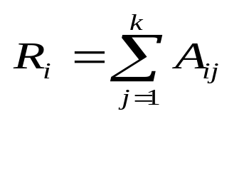
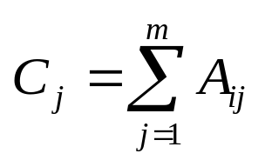
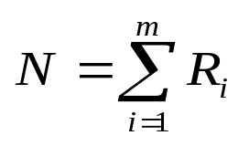
The features are individually evaluated with respect to the classes using the χ²- statistics, given by
Where,
m = number of data discretization intervals
k = number of classes
A_{ij}= number of samples in i^{th} class and j^{th} interval
E_{ij}=expected frequency of A_{ij} which is calculated by
Where R_{i} = number of samples in i^{th} interval
C_{j} = number of samples in j^{th} class
N = Total number of patterns

Slide 22
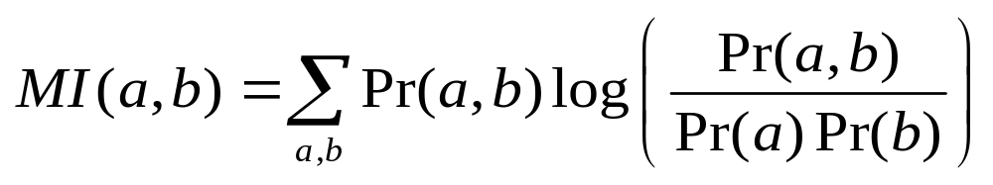
Mutual Information
Strongly dependent variable would add little information about the output hence it will be removed
Mutual Information is a measure of general interdependence between random variables.
The mutual information between random variable a and b is given by

Slide 23
Swarm Intelligence
Individuals of the swarm are incapable of doing a task.
The swarm, as a unit can accomplish the task.
This emergent property is due to the local interactions.
E.g. ants searching for food, termites building mounds, etc.

Slide 24
Swarm Algorithms
Ant Colony Optimization and Particle Swarm Optimization are inspired by swarm intelligence.

Slide 25
Emergent Problem Solving in Lasius Niger ants,
For Lasius Niger ants, [Franks, 89] observed:
  regulation of nest temperature within 1 degree celsius range;
  forming bridges;
  raiding specific areas for food;
  building and protecting nest;
  sorting brood and food items;
  cooperating in carrying large items;
  emigration of a colony;
  finding shortest route from nest to food source;
  preferentially exploiting the richest food source available.
These are swarm behaviours – beyond what any individual can do.

Slide 26
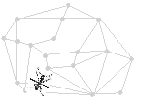
ANT Colony Optimization

Slide 27
ANT Colony Optimization
  Examples:
  Traveling salesperson problem(Dorigo, Gambradella 1997)
  Job-Shop Scheduling problem(Colorni et. al 1994)
  Graph Coloring problem(Costa and Hertz 1997)
  Quadratic Assignment Problem(Gambradella 1999)
  Vehicle routing problem(Bullnheimer 1999)

Slide 28
Basic Idea of ACO
Employ artificial ants to explore the search space.
Ants deposit pheromone on trails.
Ants can also sense the pheromone trail.
Ants make decision according to the pheromone.
Some local heuristic functions can also be used.
A pheromone evaporation mechanism is usually included to allow the colony to slow forget the past.
The best path (used by most ants) can be returned as the solution to the optimization problem.

Slide 29
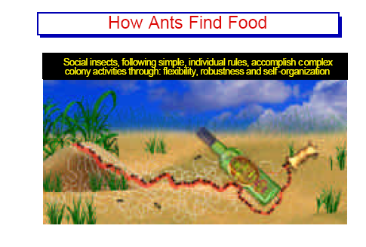

Slide 30


Ant Highway
Food Source
Ant Nest

Slide 31



Movement Of Ants
Ant Nest
Food Source
(a)
Pheromone trail
Ant Nest
Food Source
(b)

Slide 32



Obstacle Experiment
Food Source
Ant Nest

Slide 33
Establishment Of New Path
Food Source
Ant Nest

Slide 34
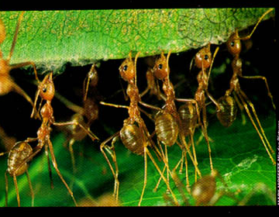
Cooperative Transport In Ants

Slide 35
ACO
ACO algorithm are multi-agent systems that exploit artificial stigmergy for the solution of combinational optimization problems.
Artificial ants live in a discrete world. They construct solutions making stochastic transition from state to state.
They deposit artifical pheromone to modify some aspects of their environment (Search Space). Pheromone is used to dynamically store past history of the colony.
Artifical ants are sometimes “augmented” with extra capabilities like local optimization or backtracking

Slide 36
Similarities with Real Ants
Colony of simple cooperative individuals.
An artificial pheromone trail is used for local stigmergetic communication.
A sequence of local moves to find shortest path.
A stochastic construction policy (exploration and exploitation) based on local information

Slide 37
Differences with real ants
Artificial ants use a discrete world
Artificial ants have internal state and memory
The deposited pheromone is proportional to the quality of the solution (some real ants have a similar behavior)
extra capabilities (look ahead, local optimization, backtracking)

Slide 38
Traveling Salesman Problem (TSP)
Problem: given N cities, and distance function d between cities, find a tour that:
1. goes through every city once and only once
2. minimizes the total distance
Problem id NP-complete
Classical combinational optimization problem to test algorithms
City 1
City 3
City 15
City 10
City 4
City 2
City 12
City 14
City 8
City 6
City 13
City 11
City 9
City 7
City 5

Slide 39
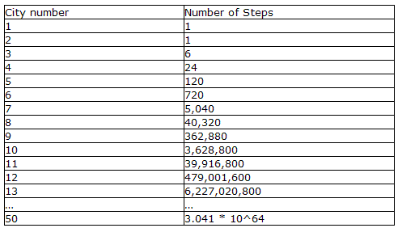
TSP

Slide 40
Optimal Route By Artificial Ants
Mimic real ants
Not completely blind
Have some memory
Environment discrete
Intelligent swarm behavior
Notes:
3

Slide 41
Traveling Salesman Problem
Consider a 4 city problem
1
η₁₂
η₁₄
η₁₃
2
4
3
η_{i:,,} the closeness (1/distance) between cities i and j-given

Slide 42
Closeness values
1
η₁₄= 2
η₁₂=1
η₁₃=2
2
4
3
The closeness between cities is computed as the inverse of the known distances between them.
η_{ij}=1/distance(i,j)

Slide 43
Pheromone concentration values
1
τ₁₂ =1
τ₁₄= 2
τ₁₃=4
2
4
3
τ_{ij} denotes the pheromone trail between the cities i and j.
Pheromone concentrations between cities are updated throughout the algorithm, till it converges.
Higher pheromone concentration on an edge gives it higher preference for selection by an ant.

Slide 44
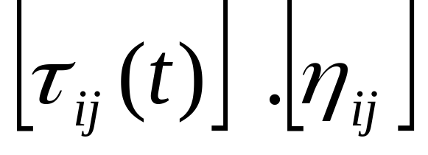
Traveling Salesman Problem contd…..
Pheromone closeness product:
Where
i -current position of the ant and
j_{k-} cities that remain to be visited by ant k
So, if the ant is on city 2, the pheromone closeness product for the edge 2 3 would be: [τ₂₃].[η₂₃]=5*1/3=1.66

Slide 45
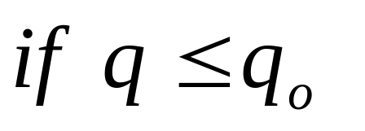
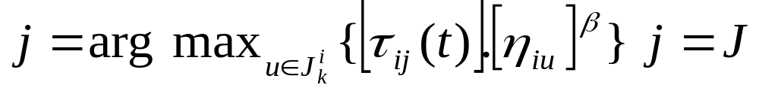
Ant Algorithm
Start : Position K ants in K random cities
Ant moves from city R to S by transition rules
Transition Rule 1 :
Where q_{o} -parameter (0< q_{o}<1) and q -random number generated between [0..1]
j -city randomly selected according to the probability calculated previously.

Slide 46
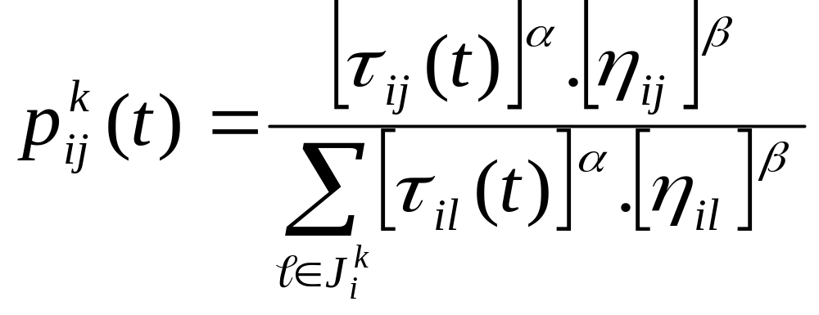
Transition rule 2
Otherwise ant k in city R chooses to move to city S
Where α and β are adjustable parameters

Slide 47
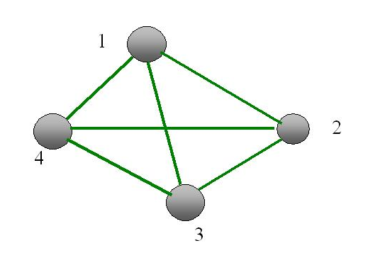
Solving our example…
We start from city 1 and need to choose the next city to move to…
Let q₀=0.7
Assume random no. generated=0.6
Apply transition rule 1
For the cities (2,3,4) we get product = (1,8,4)
Hence move to city 3
Current position

Slide 48
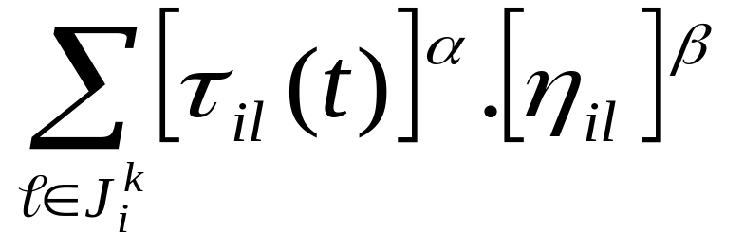
Solving our example…
If the random no. was more than 0.7, we apply transition rule 2
= 1 + 8 + 4 = 13
Hence the probabilities that we move to cities 2,3 or 4 is equal to ( 1/13 , 8/13 , 4/13 )
We see that probability to move to city 3 is greatest.

Slide 49
Solving our example…
Exploration
Generate a random number, r between 0 and 1.
Say, r = 0.40. This falls between 1/13 = 0.076 and 9/13 = 0.692
Hence, city 3 is selected as the next move.
0 1/13 9/13 1
city2 city3 city4
r = 0.40

Slide 50
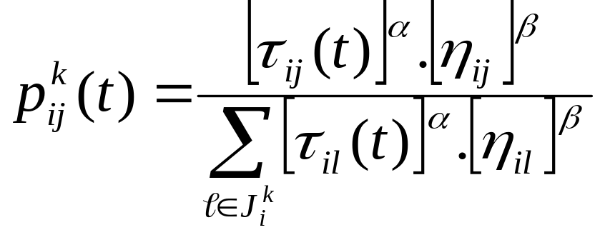
Ant System (AS) note…..
α = 0 : represents a greedy approach
β = 0 : represents rapid selection of tours that may not be optimal.
Thus, a tradeoff is necessary.

Slide 51
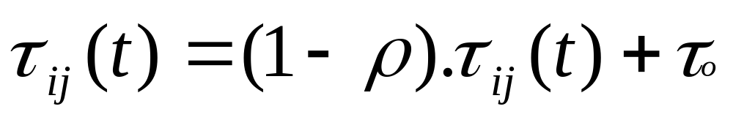
ACS Local Updating Rule
The local updating rule for the ants to visit edges and change their pheromone level is given by
Where ρ is a parameter 0< ρ<1

Slide 52
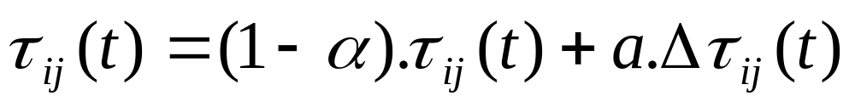
ACS Global Updating Rule
The globally best ant is that which has constructed the shortest tour.
In ACS only the globally best ant is allowed to deposit the pheromone.
Global updating is performed after all ants have completed their tours.
Hence the pheromone level is updated as per
Where α is the pheromone decay parameter [0< α<1]

Slide 53
Feature Selection with
Ant Colony Optimization

Slide 54
A hybrid SVM-ACO algorithm for feature selection
Similar to the TSP problem, but ants will conduct only a partial tour.
Ants, employing a pheromone mediated search, will choose a subset of features from the original set.
Any good filter method can be incorporated e.g. InfoGain.
SVM or any classifier can be employed as a wrapper algorithm.

Slide 55
A hybrid SVM-ACO algorithm for feature selection
Initial scoring using filter method
X₁
X₂
X₃
…
…
X₂₀
X₁₄
X₅
X₇
…
…
X₁₂
X₁₄=100
X₅ =95
X₇ =80
…
…
X₁₂ =10
Filter
Method
Score
attributes
Feature set
Ranked features
Feature scores may be used like distances in TSP

Slide 56
A hybrid SVM-ACO algorithm for feature selection
Each ant selects a subset of features, which is evaluated using a classifier like SVM.
Ant1
X₁₄ ,X₅ ,X₉ , X₁₃ ,X₂₀
SVM
Accuracy 67%
Ant2
X₇ ,X₁₅ ,X₁₉ , X₃ ,X₆
SVM
Accuracy 78%
Ant2
X₄ ,X₁₂ ,X₇ , X₁ ,X₂
SVM
Accuracy 56%

Slide 57
A hybrid SVM-ACO algorithm for feature selection
Several variations possible:
  Only pheromone information is employed
  The next pheromones and heuristic information can be employed in the form of filter-ranking.
  Either we deposit pheromone on the features themselves or on the links.
  First feature can be randomly chosen, or with a probability proportional to the weighted sum of the pheromones in the links connected to a particular feature.

Slide 58
Algorithm 1
Employ a filter method like SVM-RFE, InfoGain, etc for ranking the features.
Evaluate the feature scores employing a linear scoring system.
Feature with the better ranking will have a higher score. E.g a feature with rank#4 will have a higher score than a feature with rank#5.
Features are equivalent to the cities in the TSP.
Initialize the pheromone values on all links.
Initialize the number of ants and other algorithm parameters.
Position the first ant randomly on one of the features in the set.s
continued…

Slide 59
Algorithm 1 (contd…)
Employ the principles of exploitation and exploration to move the ant from the current feature to the next feature.
Conduct the partial tour in the same manner until maximum number of a priori fixed subset size is reached.
Depute other ants to conduct their own partial tours.
After completion of the tours of all ants, evaluate the quality of the tours employing SVM or any other classifier.
Increase the pheromone concentration of links of the best ant proportional to the quality of the tour (accuracy of the classifier).

Slide 60
Algorithm 1 (contd…)
Decrease the pheromone concentrations on all the links visited by the remaining ants.
Repeat steps 7 to 13 for a certain number of generations.

Slide 61
Evaluation of the Best Subset Size
Initially the subset size was set to 90% of the size of the original feature set.
The subset is progressively reduced to, say 10%.
Choose the subset size that gives the maximum accuracy.

Slide 62
Details of the Simulations
Employ all the instances for filter ranking.
In the subset size evaluation, take 100 random splits of 80%-20%.
Build, for each subset size, 100 different classifiers (with 80% of the data) and test on 20% of the data.
Select the subset with the maximum average test accuracy.

Slide 63
Algorithm 2
Same as algorithm 1 excepting the selection of the first feature.
A scoring system has been developed for the selection of the first feature, which depends on:
  Total no. of links connecting a feature having a pheromone value better than a threshold.
  The sum of all the pheromone values on links starting from that feature.
  The fitness value of that particular feature.
To prevent getting trapped in the local minima, the scoring system is employed in 90% of cases. 10% of the times, the first feature is selected randomly.

Slide 64
Possible Alternatives
Any good classifier can be employed as a wrapper.
Any good filter method can be employed.
A combination of filter-methods can be used with a weighted scoring system of features.
For example, if different filter methods choose certain features in the top few positions, these features can be given more score.

Slide 65
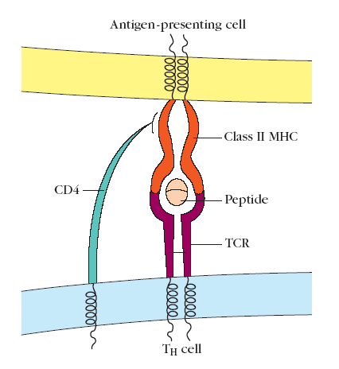
Feature-selection for the Prediction of T-cell epitopes
T-Cell Epitopes
T cells recognize only peptides combined with MHC molecules on the surface of antigen-presenting cells and altered self-cells
Antigenic peptides recognized by T cells form trimolecular complexes with a T-cell receptor and an MHC molecule
T-cell epitopes, as a rule, cannot be considered apart from their associated MHC molecules.

Slide 66
Feature-selection for the Prediction of T-cell epitopes
T-Cell Epitopes
Antigen processing is required to generate peptides that interact specifically with MHC molecules.
Epitopes recognized by T cells are often internal.
Binding of T-cell epitopes to MHC varies with different MHC alleles.

Slide 67
Why predict epitopes?
Reliable in silico prediction of epitopes would lessen the burden required for laboratory analysis of viral, bacterial and parasitic gene products.
This, in turn will dramatically cut down expenses in time and money for vaccine design.
Clinical implications of drug immunogenicity is severe. Therefore, it is desirable to know whether a proteinaceous drug is antigenic by nature.

Slide 68
Feature-selection for the Prediction of T-cell epitopes
CoEPrA 2006 dataset #1
Dataset borrowed from Doytchinova et al.
177 nonameric peptides with known binding affinities (pIC50) to HLA-A*0201.
Peptides with pIC50 in range 7.793 to 8.403 were labeled as positive. pIC50 between 5.010 and 7.748 were labeled as negative.
88 epitopes and 89 non-epitopes respectively.

Slide 69
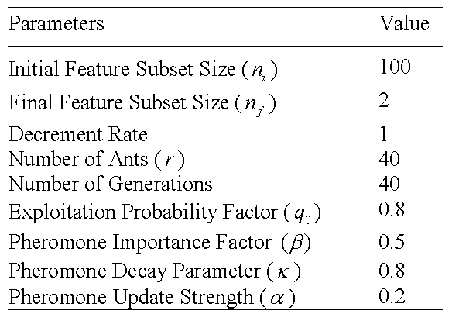
Feature-selection for the Prediction of T-cell epitopes
No new features were added.
The features were linearly scaled from 0 to 1.
Ant colony optimization parameters:

Slide 70
Feature-selection for the Prediction of T-cell epitopes
A linear kernel was found to outperform the polynomial and RBF kernels for this task, with the value of C=100.
Many feature subsets of size within the range 100 to 2 obtained a LOOCV Accuracy of 100%.
The calibration dataset of total 89 nona-peptides was divided into a training dataset of 69 nona-peptides and testing set of 20 nona-peptides.
A feature subset of size 58 features obtained an accuracy of 97.3450% which was highest among all the other subsets which obtained a 100% LOOCV accuracy.

Slide 71
Feature-selection for the Prediction of T-cell epitopes
The subset of 58 features was then employed to train the SVM model using the complete calibration dataset of 89 nona-peptides, and predictions on the prediction dataset were made.
The results indicate that eight epitopes and four non-epitopes were misclassified.
MCC of 0.5261with Algorithm 1. Ranked 16th best in CoEPrA competition.
MCC of 0.577 with Algorithm 2.
For comparisons, the dataset was run down some well-known prediction servers. A best MCC value of 0.4588 was obtained with the EpiJen server.

Slide 72
Conclusions
Easy to implement.
Very flexible.
Superior performance.
Picks up the correlations between features.

Slide 73
Microarray Gene Selection with SVM

Slide 74
Leukemia Dataset
Training Set (38 samples)
  Class 1: 11 Acute Myeloid Leukemia (AML)
  Class 2: 27 Acute Lymphoblastic Leukemia (ALL)
Testing (34 samples)
  14 AML and 20 ALL samples
Gene Expression Level : 7129
    Ref: Golub et al. (1999) Molecular classification of cancer: class discovery and class prediction by gene expression monitoring. Science, 286, 531–537.

Slide 75
Colon Dataset
Training Set (40 samples)
  Class 1: 14 Normal Colon Tissues (NCT)
  Class 2: 26 Tumor Colon Tissues (TCT)
Testing (22 samples)
  8 NCT and 14 TCT samples
Gene Expression Level : 2000
    Ref: Alon et al. (1999) Broad patterns of gene expression revealed by clustering analysis of tumor and normal colon tissues probed by oligonucleotide arrays. Proc. Natl Acad. Sci. USA, 96, 6745–6750.

Slide 76
Why Gene Selection?
a small subset of genes responsible for particular biological properties
Important to identify the most informative genes
Reduce Cost in handling
Improve Model

Slide 77
Results for Leukemia classification with gene selection
No of Genes Accuracy
40 34/34
5 31/34

Slide 78
Prediction of protein disorder
Disordered proteins are proteins containing segments that fail to fold on their own.
The biologically active states of many of these proteins are attained only after binding to another protein or a ligand, with several disordered stretches of amino acids serving useful functions.
Such proteins are typically difficult to crystallize, which makes the in silico prediction of disordered proteins an important problem in structural proteomics.

Slide 79
Prediction of protein disorder
Datasets:
A set of disordered proteins with disordered stretches of length greater than 30 aa were taken from the DisProt database.
For the negative set, all chains that contain residues with missing backbone coordinates were removed from PDB_S_25 to create the ORDERED_PDB_SELECT_25 dataset of completely ordered proteins.

Slide 80
Prediction of protein disorder
Features
Several physicochemical properties taken from AAIndex.
The values of the physicochemical properties as per the AAIndex were averaged out and taken as features.

Slide 81
Prediction of protein disorder
Feature selection and classification
Feature selection was done by ranking the features using InfoGain, and using this in ACO.
For classification, SVM was employed and performance evaluated using 10-fold cross validation.

Slide 82
Prediction of protein disorder
Results
Mean hydrophobicity (Kyte-Doolittle scale) and net charge were found to be the most important features
CV accuracy with all features: ~ < 75%
CV accuracy with best 2 features: ~ > 80%

Slide 83
SVM-based method for predicting the propensity of a protein to be soluble or to form inclusion body on over expression in E- coli
Notes:
A support vector machine-based method for predicting the propensity of a protein to be soluble or to form inclusion body on overexpression in Escherichia coli
Susan Idicula-Thomas ^{1,} , Abhijit J. Kulkarni ^{2,} , Bhaskar D. Kulkarni ², Valadi K. Jayaraman ^{2,*} and Petety V. Balaji
Bioinformatics 2006 22(3):278-284

Slide 84
Introduction
The formation of inclusion bodies is known to be an outcome of improper protein folding
Major influencing factor - Composition and arrangement of amino acids in the proteins

Slide 85
Significant Need for a Prediction Algorithm
Identification of both mutants and also the ideal protein candidates for mutations that would confer higher solubility-on-overexpression

Slide 86
Dataset
Training
Positives - 41
Negatives - 87
Testing
Positives-21
Negatives-43

Slide 87
Features used
Reduced alphabet
Physicochemical parameters
Aminoacid composition
Dipeptide composition
Tripeptide composition
Hybrid Modules

Slide 88
Physicochemical properties
Length of the protein
Hydropathic index
Aliphatic Index
Instability index of the entire protein
Instability index of N-terminus
Net charge

Slide 89
Results
Hybrid Module performs well
Predict the change in solubility for most of the point mutations reported in literature
Algorithm can be a useful tool in screening protein libraries to identify soluble variants of proteins

Slide 90
Results
The performance was found to increase significantly on using only the top 20 features selected from the 446.
The best features included a few dipeptide frequencies, a few amino acid frequencies , net charge and GRAVY.
SVM trained with the best features gave an accuracy ~ 75%.

Slide 91
An Ant Colony Algorithm for Data Mining

Slide 92
Methods for Classification
Neural Network based methods
Kernel based methods
Statistics based methods
  Logistic regression
Rule based methods
  Fuzzy based approach
  Genetic algorithms
  Ant colony optimization

Slide 93
Data Mining
Consists of extracting useful knowledge from data
Discovered knowledge is often represented in the form of prediction (or classification) IF—THEN rules
Rule based classification, is one very important class of data mining problems
Classification task consists of associating each (object, or record) to one class, out of a set of predefined classes, based on the values of some predictor attributes for the object

Slide 94
IF—THEN Rules
Extracted knowledge is often simplified in the form: IF <conditions> THEN <class>
The antecedent (IF part) of the rule contains a logical combination of predictor attributes, in the form: term1 AND term2 AND ...
Each term is a triple <attribute, operator, value>, such as <Gender = Female>
The consequent (THEN part) of the rule contains the class predicted for objects whose attributes satisfy the antecedent (IF part) of the rule

Slide 95
IF—THEN Rules
For example, people play different sports depend on weather conditions, some observations can be put into rules as:
  IF outlook=sunny AND humidity=high THEN swimming
  IF outlook=sunny AND humidity=low THEN cricket
This formation handles attributes with nominal values
The attributes with continuous values need to discretized to use IF-THEN kind of knowledge representation

Slide 96
Illustrative Example: Classification of disordered and ordered proteins
Disordered proteins refer to those proteins containing segments that fail to fold on their own.
The disordered regions of these proteins lack a specific tertiary structure, and typically are composed of an ensemble of conformations, with dynamically varying backbone torsion angles.
The classification of disordered proteins is an important problem in structural proteomics, since structure determination for such proteins are not feasible by experimental methods.
Dunker et al. had shown that the binary classification of disordered and ordered proteins can be done using only the avg. hydrophobicity and net charge as features.

Slide 97
Discretization of Continuous Variables
Several machine learning techniques handle nominal attributes
Different methods are proposed such as
  Equal interval width
  Entropy based methods
  Vector quantization
  K-means clustering

Slide 98
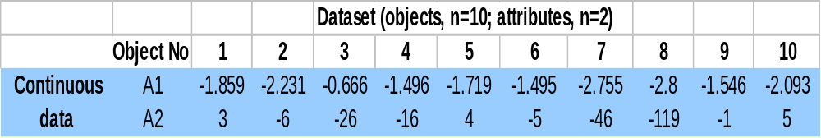
Illustrative Example
Consider a dataset of N=10 points need to be discretized.
Attribute A1is the mean hydrophobicity of the protein sequence, and A2 is the net charge.
The first 5 points correspond to ordered proteins, and the last 5 are disordered proteins.
In equal width binning, divide range of each attribute in domain of equal length.
For example, attribute A₁ has values in the range –0.666 to –2.8, divide it into, say 3 domains of equal length which gives, Term₁₁ = A1 ≤ -2.08, Term₁₂= -2.08 < A1 ≤ -1.3764, and Term₁₃= A1 > -1.3764

Slide 99
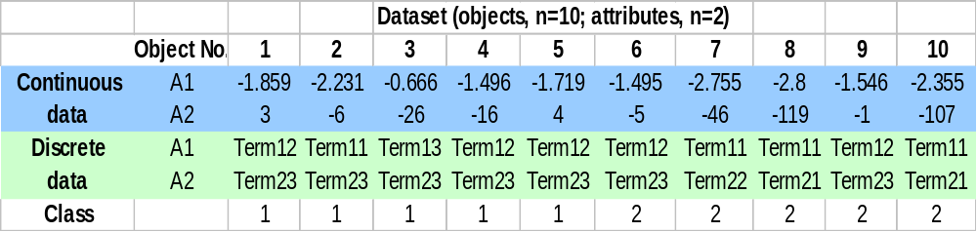
Illustrative Example
Similarly, attribute A2 is discretized into 3 domains of equal length
The dataset in the discretized form is given as:
Last row represents association of each object to one of the two classes

Slide 100
Discovery of Classification Rules by Ant’s Way

Slide 101
Properties of Ant Algorithm
Solution representation
Fitness function
Pheromone trail representation
Environment
Probability function
Memory
Trail Updating

Slide 102

Solution Representation
Ant constructs a string of solution containing both IF and THEN parts
Consider a representative solution as:
It can be interpreted as: For an object, IF attribute A1≤ -2.08 AND A2 ≤ -119 THEN its class is 2.
Literally, this means a protein sequence having avg. hydrophobicity ≤ -2.08 and net charge ≤ -119 belongs to the disordered class.
Illustrative rule shows that it can contain only one term from each attribute

Slide 103
Fitness Function
Training set consists of N objects categorized into one of the classes, C
Fitness of a discovered rule is given as: Q=(TP-FP)/N
TP is the number of cases covered by the rule that have the class predicted by the rule
FP is the number of cases covered by the rule that have a class different from the class predicted by the rule

Slide 104
Fitness Function
For example, rule cover two objects from class 2 of training dataset N=10
The rule has values of TP = 2, and FP = 0 that gives its fitness as Q=2/10

Slide 105
Pheromone Trail Representation
Consider attributes A1 and A2
Domains of attribute A1 and A2 are {Term₁₁, Term₁₂, Term₁₃} and {Term₂₁, Term₂₂, Term₂₃} respectively
Each attribute is giving 3 terms
To construct a rule, ant has choice of selecting terms out of total six terms
Thus, pheromone matrix represents number of available terms.

Slide 106
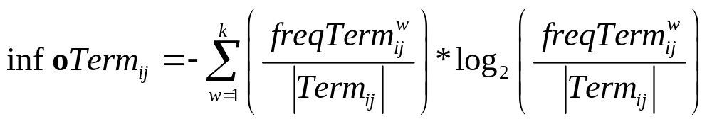
Heuristic function used
k - no. of classes.
|Term_{ij}| - total no. of objects in partition Term_{ij} ( attributes A_{i} has value V_{ij}).
freqTerm_{ij}^{w} – no. of cases in Term_{ij} that have class w.

Slide 107
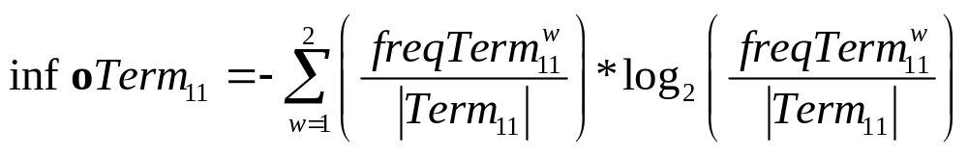
Heuristic function used
Example
= -(1/4*log₂(1/4)) + (¾*log₂(3/4))
=-(0.25*-2) + (0.75*-0.4150)
=-(-0.5 - 0.3112)
=0.8113
Similarly compute the infoTerm_{ij} for all the other terms.

Slide 108
Information Gain (contd..)
More number of examples belonging to one class means more information.
Information gain can be employed as a problem knowledge.
Information gain can be employed to rank terms.
η_{ij} represents score of the term_{ij.}

Slide 109
Selection of Terms
Employ exploration
and
exploitation.

Slide 110
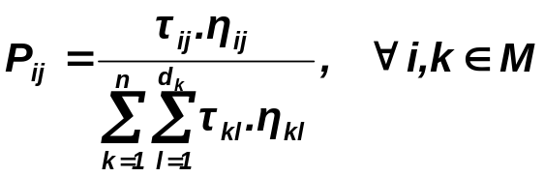
Probability Function
Ant selects term Term_{ij} to add in the current partial rule with probability P_{ij} that depends on its trail value τ_{ij} and heuristic information η_{ij}
Probability equation can be given as:
P_{ij} is a normalized probability of choosing term T_{ij}, n is the number of attributes, d_{k} is the number of domains of attribute A_{k}, η_{ij} is the value of problem dependent heuristic function for term T_{ij}, M is the list of attributes not yet used by the agent

Slide 111
Memory
Each ant starts with empty rule (solution) i.e. no term in its antecedent and adds one term at a time in its current partial rule using probability function
Solution contains terms equal to no. of attributes defining an object (pattern)
It can contain only one term from each attribute

Slide 112

Rule Construction— IF Part
To add a term Term_{ij} in the current partial rule ant calculates its selection probability, P_{ij}
Selected term Term_{ij} will be added in the current partial rule if it covers at least minimum no. of objects to be covered (known a priori) from the training set
For example, consider rule constructed by an ant, suppose each term should cover min. no. of objects=2
Term₁₁ covers 4 objects while term Term₂₁ covers 2 objects from the dataset N=10, combining them cover at least min. no. of objects (i.e. two)

Slide 113
Rule Construction— THEN Part
Ant constructs only antecedent (IF part) of rule
Consequent (THEN part) of the rule is determined from the no. of objects covered by the antecedent (IF part) of the rule
For example, suppose ant has constructed the antecedent of the rule as
Term₁₁ and Term₂₁ together cover 2 objects from the dataset, N=10
Both covered cases are belonging to class 2 so consequent of the rule is C₂
Complete rule can be given as:

Slide 114
Pheromone Trail Updating
Once ant generates a rule,
pheromone trail is updated as:
ρ is persistence of trail, (1- ρ) is evaporation rate, Q is the quality (fitness) of rule
At each iteration, R ants take part in trail updating process

Slide 115
Termination of Rule Generation Process
When all the ants generate their solutions (rules), their fitness is calculated
Rule with highest fitness value is considered as the best rule discovered by the ants and stored separately in the rule list
Objects covered by the ‘best rule’ are removed from the training set, thus in the next iteration, ants work on reduced training set
Process continues till ants generate rules covering almost all the objects of training set

Slide 116
Ant Algorithm
Algorithm starts with complete training set
Each ant start with empty rule
Add one term at a time using probability function and minimum_no_cover_objects parameter, this gives antecedent (IF part) of rule
Consequent (THEN part) of rule is a class that represents maximum no. of objects covered by the antecedent of the rule
Find predictive accuracy (quality) of the rule
Update the pheromone trail using quality of the rule
Repeat step 2-6 for given no. of ant, R

Slide 117
Ant Algorithm
Obtain the rule with highest quality from currently constructed R rules
Store this rule in the rule list as discovered rule
Remove the objects from the training set that are covered by the discovered rule
Repeat steps 2-10 until almost all the objects are covered from the training set

Slide 118
Discovered Rules
A rule set discovered can be used to predict class of unseen objects (i.e. objects that were not part of the training set)
Each rule tries to match its antecedent with the predictor attributes of the object
If it matches, the rule assigns its consequent as a class to the unseen object

Slide 119
Rule Pruning and Term Pruning
It is possible to prune both terms and rules.
Terms are to be pruned at every iteration.
Rules are to be pruned at the end.

Slide 120
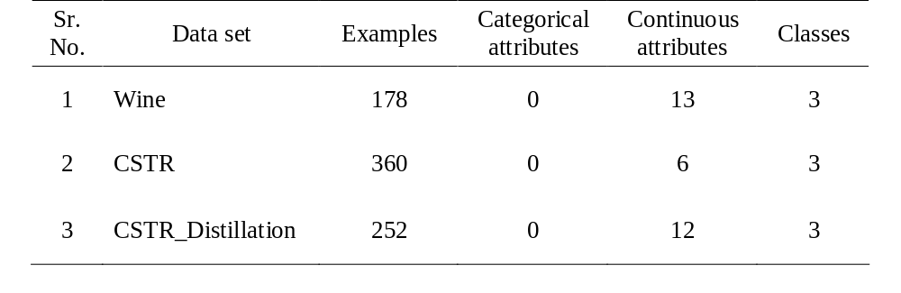
Illustrative Data Sets for Study

Slide 121
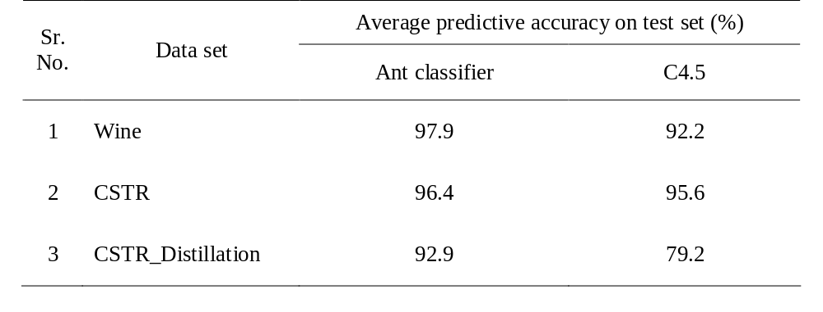
Average Predictive Accuracy Rate Attained by Algorithms

Slide 122
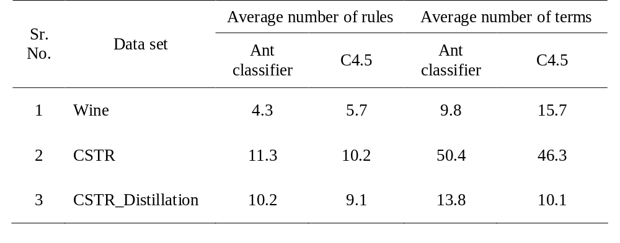
Measure of Simplicity of Rule Sets Discovered by Algorithms

Slide 123
E.COLI GROWTH / NO GROWTH
Predict Growth/No Growth
2: Attributes Combinations of Different Temperature and water Activity

Slide 124
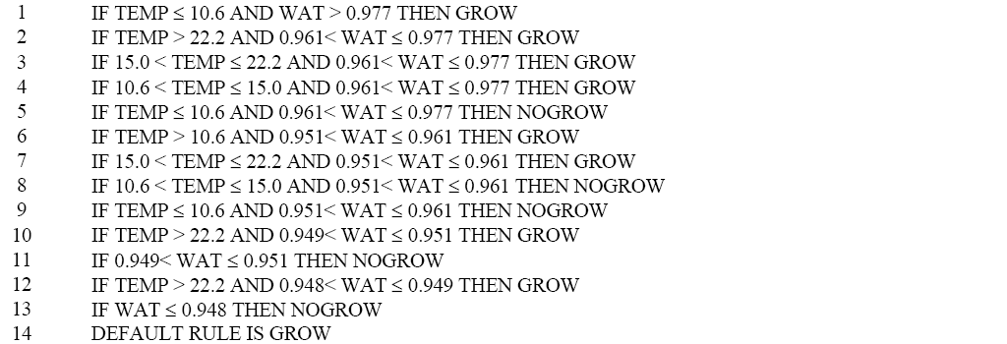

Slide 125
Applications
Image pattern recognition
Medical diagnostic
Protein data expression
Gene data folding

Slide 126
References
Parpinelli, R. S., Lopes, H. S., & Freitas, A. A. (2002). An ant colony algorithm for classification rule discovery. In H. Abbas, R. Sarker, & C. Newton (Eds.), Data mining: A heuristic approach (pp. 191–208). London, UK: Idea group publishing.
Shelokar, P. S. , Jayaraman, V. K., & Kulkarni, B. D. (2004). An ant colony classifier system: application to some process engineering problems, Computers & Chemical Engineering,28(9) 1577-1584

